Slide 1
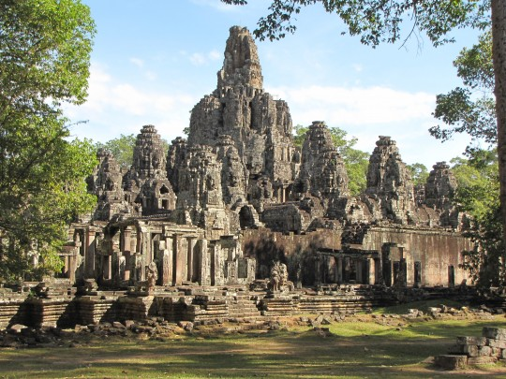
Kingdom of Cambodia
KHMER

Slide 2
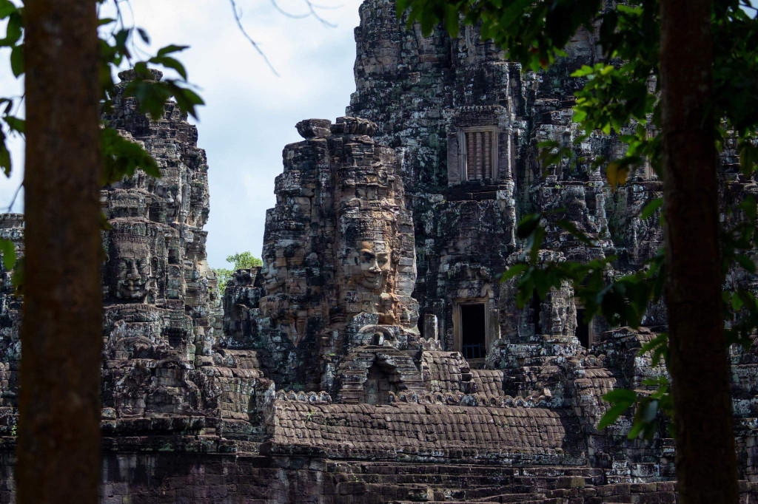
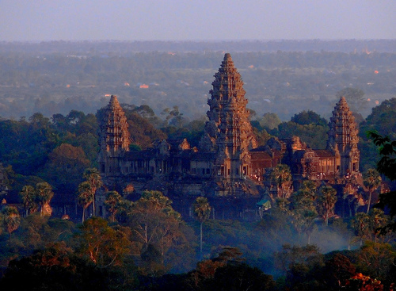
Contents
About Cambodia
  Cambodia National Flag
  The King of Cambodia
  Royal Government of Cambodia
People
Culture
  Dress in Cambodia
  Tourism
  Learn Khmer words

Slide 3
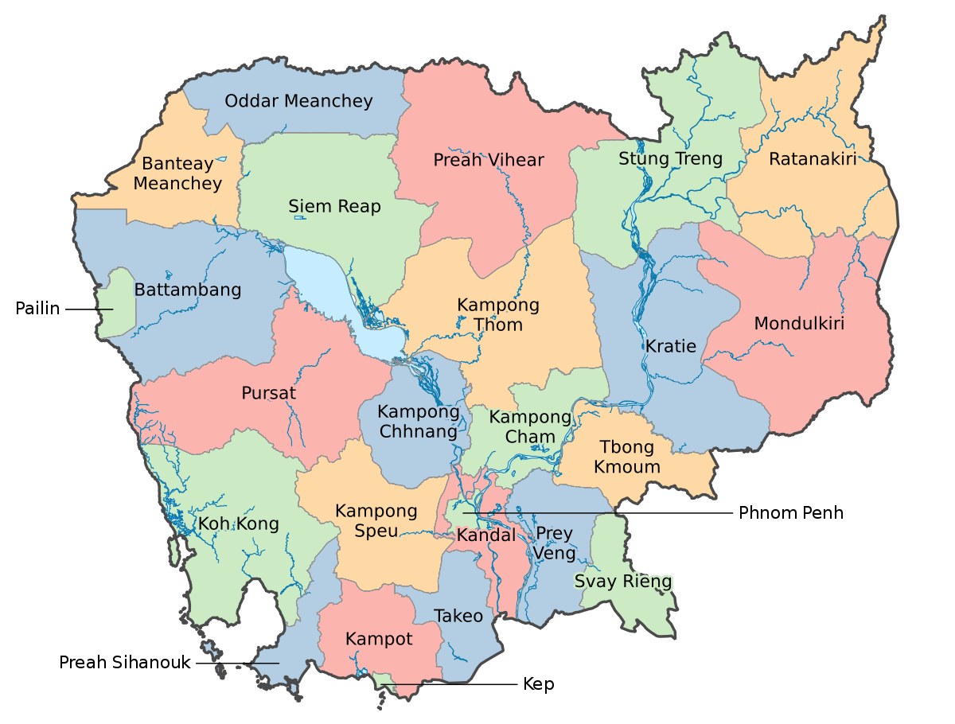
About Cambodia
Cambodia is a country situated in Southeast Asia region and it is home to more than 16 million people. Its territory is 181 035 square kilometers.

Slide 4
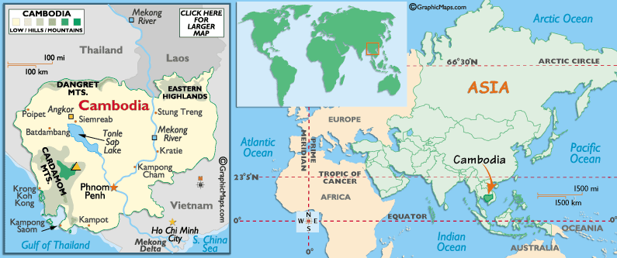
Cambodia Location and Features

Slide 5
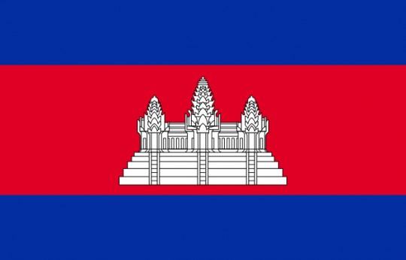
Flags of Cambodia
The Cambodian flag's colors are very important to the country.

Slide 6
Flags of Cambodia
Angkor Wat’s white color: the color represents the country’s beliefs and religions, especially Buddhism and the value of dignity related to the universe.
The two blue color bands: blue describes the feeling of unity, freedom, and alliance for all Cambodian citizens. Also, it symbolizes the King and monarchy.
Red color band: bravery is considered a red color in Cambodia. It means that the country has gone through a bitter history of war.

Slide 7
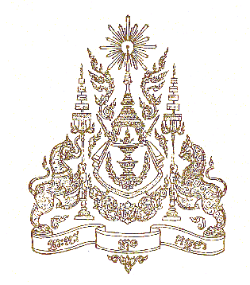
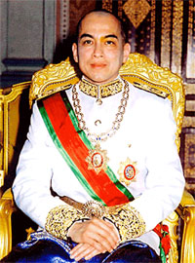
The King of Cambodia
His Majesty King Nododom Sihamoni

Slide 8
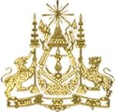
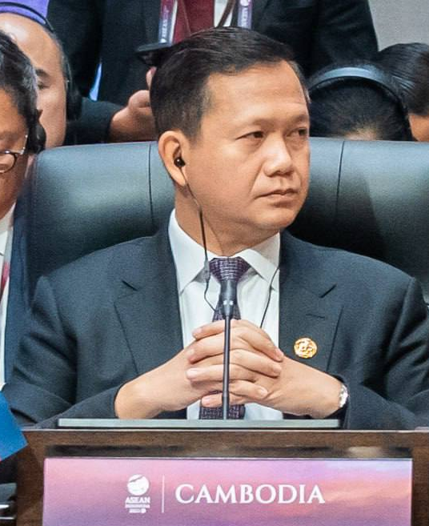
Royal Government of Cambodia
. Samdech Moha Borvor Thipadei HUN MANET,
Prime Minister of Cambodia.

Slide 9
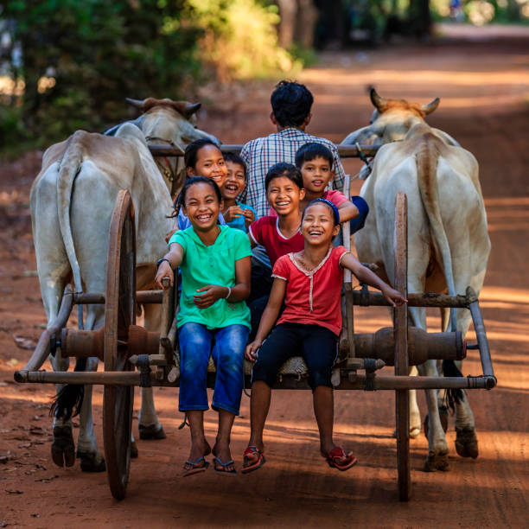
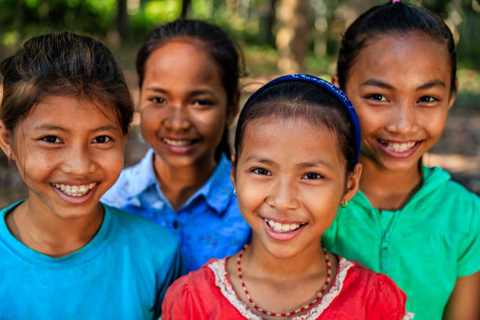
People
The people of Cambodia are among the most resilient people.
Having experienced years of tortuous war, poverty and horror, we remain courteous, friendly and welcoming.
You'll love the constant array of gentle and smiling faces and the best compliment to pay your hosts is to remain cool-tempered, calm and ready for some warm acquaintance, fun and even laughter.
Cambodia population 16,767,842 (World bank, 2022) Vietnamese, Chinese, Chams and other minorities also live in the country.

Slide 10
History of Cambodia
Cambodia is a South East Asian Country and that as Phnom Penh as its capital city. The states of Funan and Chenla were previously assumed by the historians to be closely related to the countries of China and India
The Khmer Empire rose into power and thrived during the period from 9th century to13th century. After the fall of the states. History of Cambodia that the center power in the Angkor and China of capitals were built here among with temples. But during 1432 the capital was shifted to Lovek.
Cambodia, to protect King Norodom in the year of 1863 asked for protection of France. Cambodia became and continued as the protectorate of France from the years of 1863 to 1953.

Slide 11
History of Cambodia
A French colony developed in this country. But on the November 9, 1953, Cambodia attained its independence and came under the constitutional monarchy of King Norodom Sihanouk.
In the years of 1975, the Khmer Rouge again rose to power and reached Phnom Penh and changed the name of the country Cambodia to the Democratic Kampuchea.
After all these violence meted out to the nation and its people in the 1970s and the 1980s the renovation process again started to bring back the political stability to Cambodia. Cambodia has been helped economically by various developed countries like France, Australia Japan, Canada, and the United States.
In 1993, we start the first election was helped UN.

Slide 12
Culture in Cambodia
Throughout Cambodia's long history, a major source of inspiration was from religion.
Throughout nearly two millennium, Cambodians developed a unique Khmer belief from the syncreticism of indigenous animisticbeliefs and the Indian religions of Buddhism and Hinduism.
Indian culture and civilization, including its language and arts reached mainland Southeast Asia around the 1st century.

Slide 13
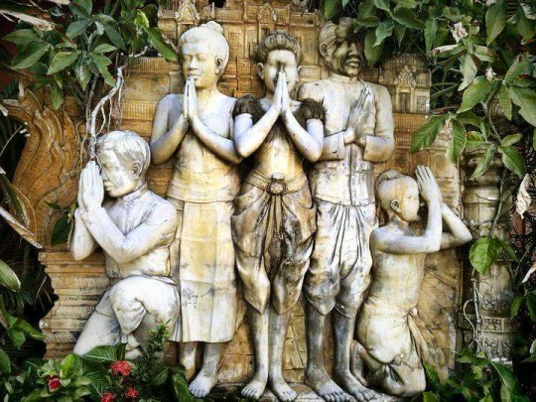
Greetings
Men should not look women directly in the eye. (They may become confused, feel uncomfortable, nervous, shy, and not respected.)
Men should not hug, kiss, or touch the body of a Khmer woman while greeting her. (She will lose respect and feel embarrassed.)

Slide 14
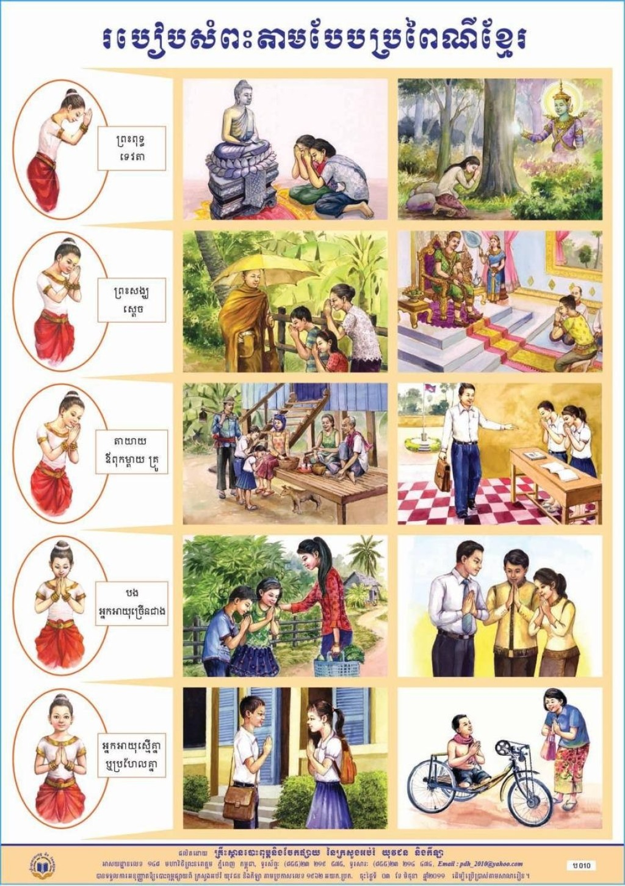
Five level of Greeting
Sampeah is a form of greeting, it is also a common way to say thanks or apologize and is an important part of Khmer culture.
Chest Level: Since the sampeah is hierarchical, the first Sampeah gesture is on the chest. It is used when you greet friends or other people of the same age or status by placing the budding lotus's hands on the chest.
Mouth Level: The second one is mostly seen in the palms' positioning on the mouth. It is utilized to greet, thank you, sorry, or say goodbye to people with higher statuses, such as older relatives, bosses, and so on.
Nose Level: The third Sampeah is put at the nose with a head bowing down a little bit. This gesture must be used to show respect to parents, grandparents, teachers, or the elderly.

Slide 15
Five level of Greeting
Eyebrow Level: The fourth one is for respecting the king, monks, or female and male monastics
Forehead Level: Last but not least, in the case of praying to Buddha, Gods, sacred statues, or temples.
Cambodians believe that the head is the most important portion of the body since it is the headquarters of wisdom and spiritual essence. As a result, patting or touching someone's head is a serious insult.
Western cultural impact is now recognized in Cambodia. Cambodian men often exchange handshakes.

Slide 16
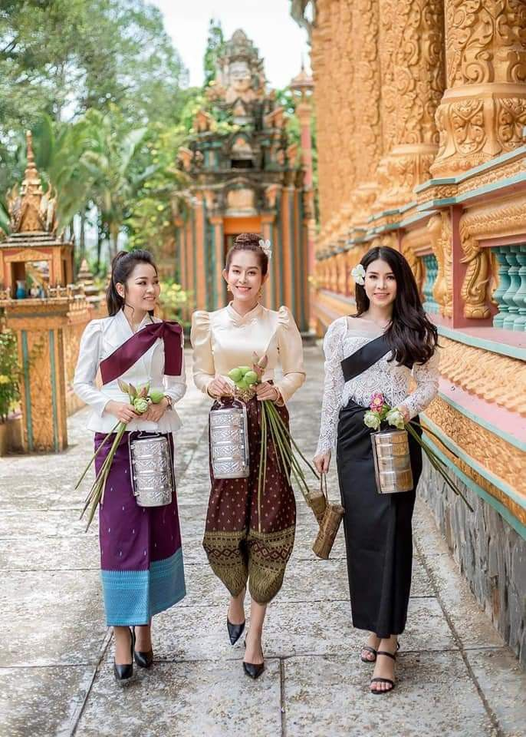
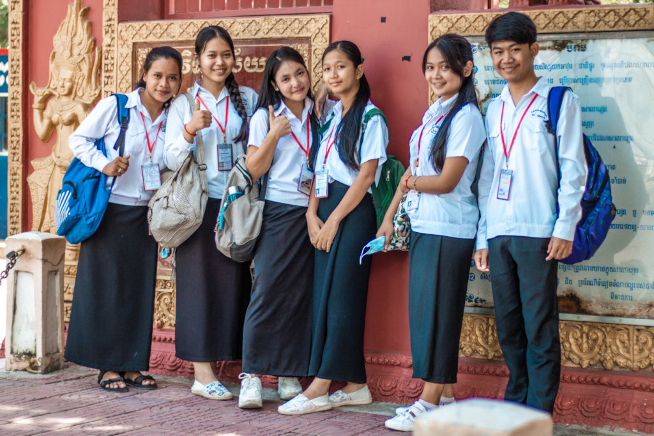
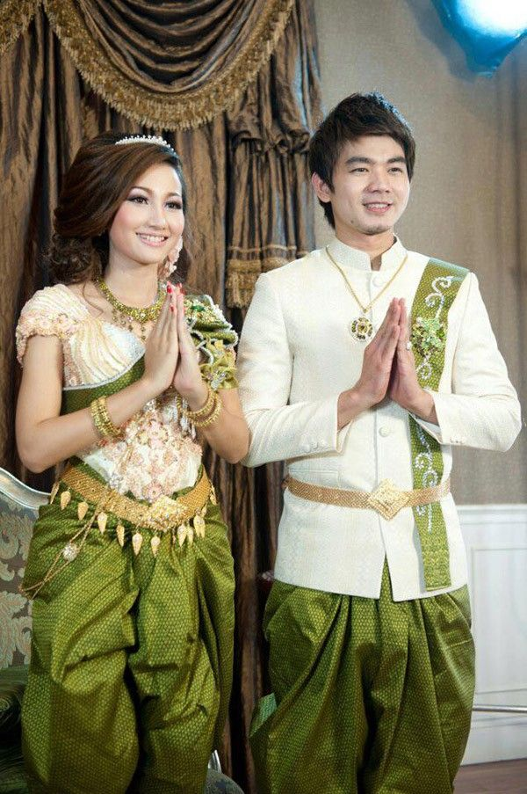
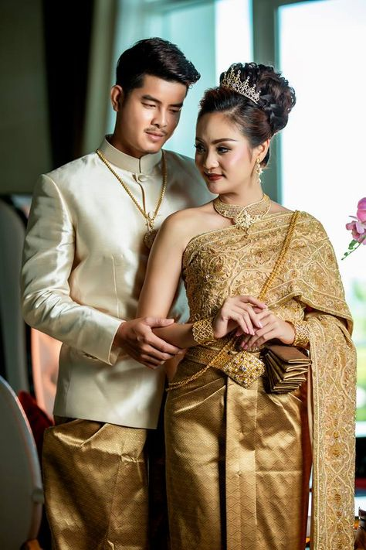
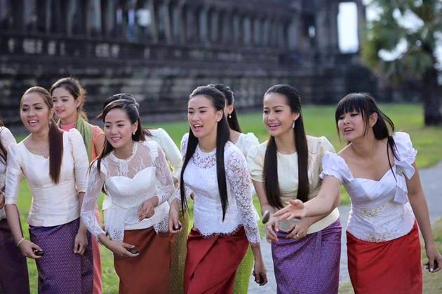
Dress in Cambodia
Traditional costume
Khmer new year
Student uniform:
Wedding Dress

Slide 17
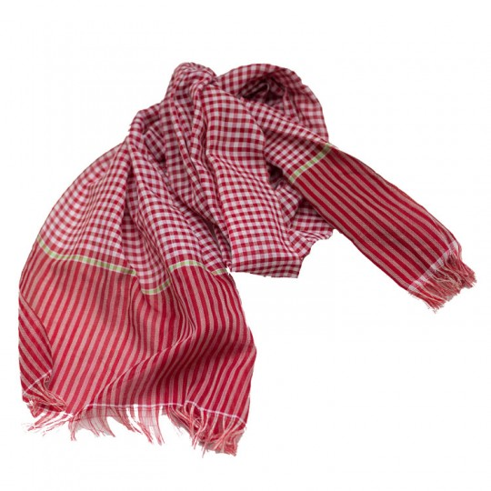
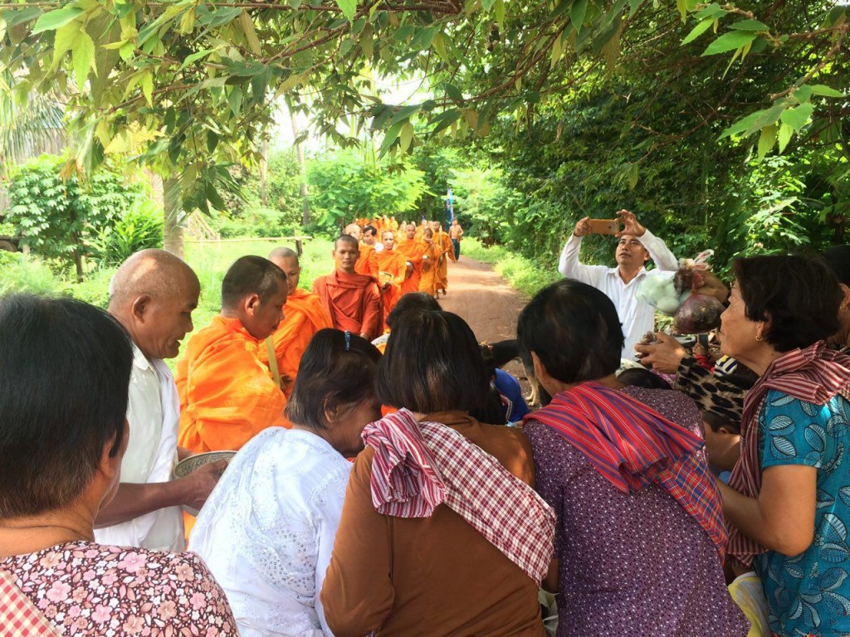
Krama (Khmer Scarf)
Kramar is a sturdy traditional Cambodian garment and signifies the Khmer cultural identity with many daily-life uses and ornate by all segments and religions

Slide 18
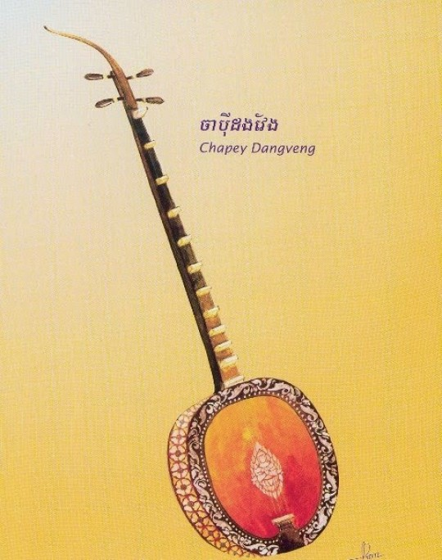
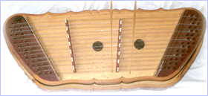
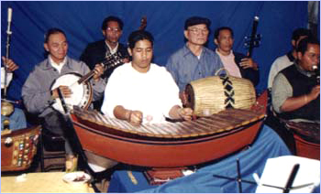
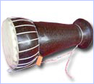
Cambodian or Khmer Music
Chapei Dang Veng is a tool for singing, and this singing is also used as a poem or Komrorng Kev which recall the rules of ancestral’ moral conduct in living, proverb or describing various stories folk. Most of the singing are delivered with beautiful sound and artists can choose to perform solo or couple. The singer was singing and playing at the same time. In the form of Chapei Dang Veng, Chapei Dang Veng is tuned follow the sound of a singer.
This kind of music is used to accompany dance, theatre, wedding and other ceremonies.

Slide 19
What Are Traditional Dances in Cambodian Culture?
Traditional Dances
here are three primary types of Cambodian dance:
1. Khmer Classical Dances (also known as Court Dances).
2. Folk Dances (which portray traditional tribal life).
3. Social Dances (popular dances)

Slide 20
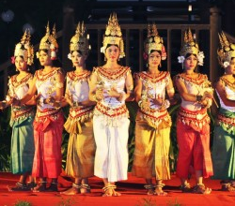
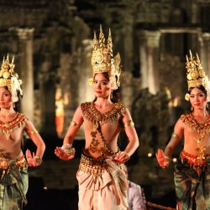
Classical Dance
Cambodia is a country with a long history. Its rich cultures portray itself in many different forms including dance.
Apsara Dance is one of many dances in the Khmer Classical Dance. This dance invented in the mid-20th Century by the Royal Ballet of Cambodia, under the patronage of Queen Sisowat Kosamak.
Apsara Dance is one of many repertory dances of The Royal Ballet of Cambodia that has been listed and proclaimed as a Masterpiece of Oral and Intangible Heritage of Humanity by UNESCO on November 2003.
Apsara Dance-One of the Repertory of Dances to the Royal Ballet of Cambodia

Slide 21
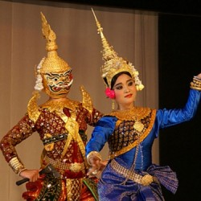
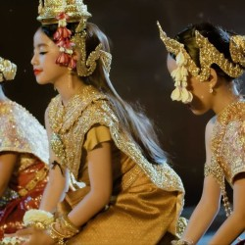
Classical Dance
Besides the cultural heritage, ancient temples, and traditional arts, there are intangible cultural heritages everywhere in Cambodia.
Being one of many repertories of Cambodian Classical dance, Robam Moni Mekhala (របាំមណីមេខលា), highlights the Cambodian mythology of thunder, lightning, and rain that is related with Buddhist and Hindu superstition.
Robam Jun Por (Blessing Dance) is a piece of art cultivated by Queen Sisowath Kosamak Nearyrath. The dance is meant to welcome and convey blessings and well wishes to the visitors//distinguished guests.
Moni Mekhala
Robam Jun Por (Blessing Dance)

Slide 22
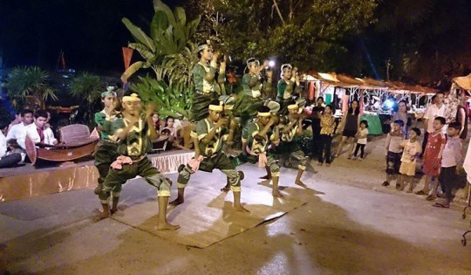
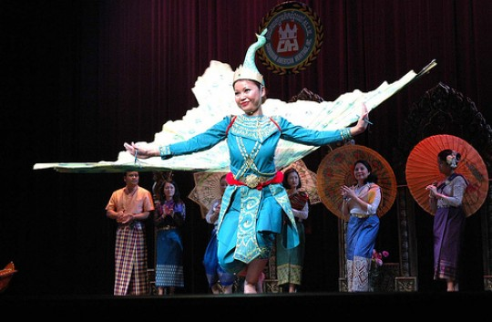
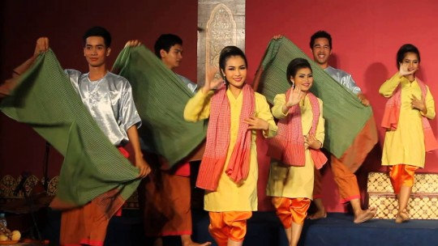
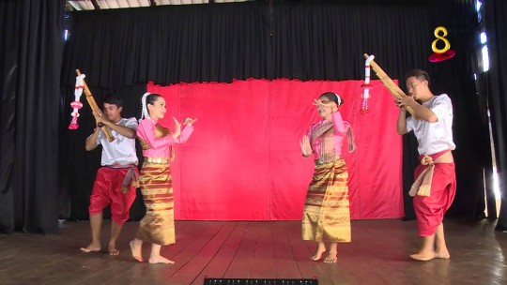
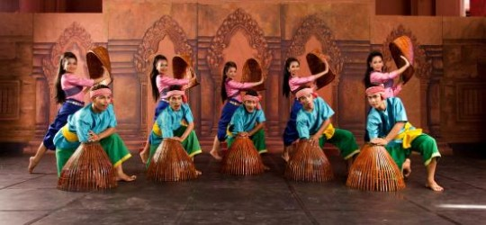
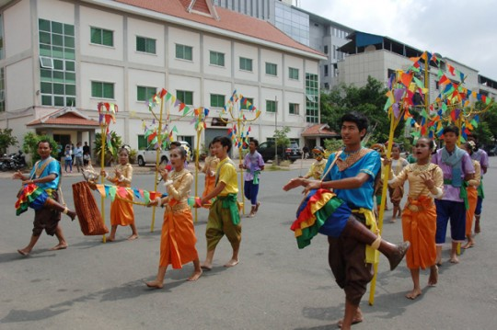
Folk Dances
Khmer folk dances are usually from locals, which bring the real life or story onto the stage and sometimes bring some message to the audience.
Robam Kandob Ses (Praying Mantis Dance)
to participate in the wedding ceremony
Pailin Peacoc Dance
is a long-standing legacy from the Kola ethnic group
Khmer Scarf Dance
is created to demonstrate the everyday life of the old Cambodians.
Robam Ken (Ken Dance)
the Ken dance is often performed at New Year celebrations
Khmer Fishing Dance
Trot Dance

Slide 23
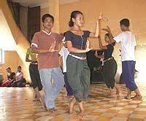
Popular dance
The popular dance is usually performed at social gatherings like weddings, parties, Khmer New Year celebrations, and festivals.
Cambodian Social dances are Rom Kbach, Rom Vong, Saravan, Lam Leav, Jok Kampeus, etc.

Slide 24
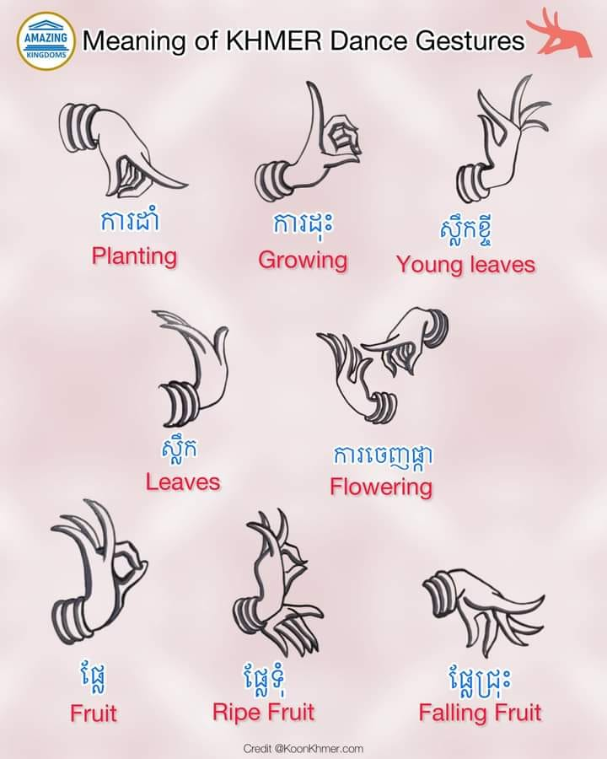

Slide 25
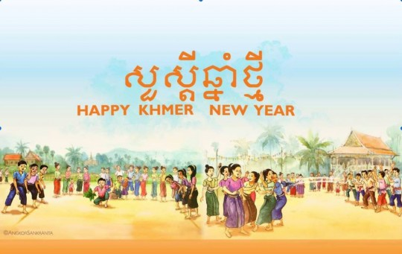
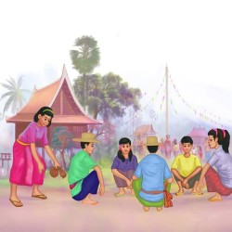
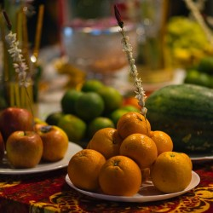
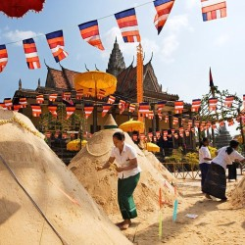
Festival in Cambodia
New Year Festival
Khmer New Year, also known as "Choul Chnam Thmey," meaning entering the new year.
The event is Cambodia's largest event and lasts three days, on the 13th, 14th, or 15th of April.
Day 1: Maha Songkran
People clean their houses, and every single corner is checked. Each household displays flowers, lighting, delightful foods, fresh produce, traditional Khmer cuisines, and canned beverages for the interior altar and the spirit palace.
Day 2: Virak Vanabat
We go to pagoda and play some games.
1. Playing Khmer traditional games, "Chol Chhoung."
2. Scarf Hidden Game is called "Leak Kon Saeng."
3. Tugging Game or "Teanh Proat."
4. Bos AngKunh
Day 3: Vearak Loeng Sak
Cambodians use holy fragrant water to cleanse Buddha statues Parents and their elders. Bathing the Buddha statues is a ceremonial ritual that locals believe washes away the sadness, sorrow, and sinful behaviors, replicating how clean water can wash the dirty things

Slide 26
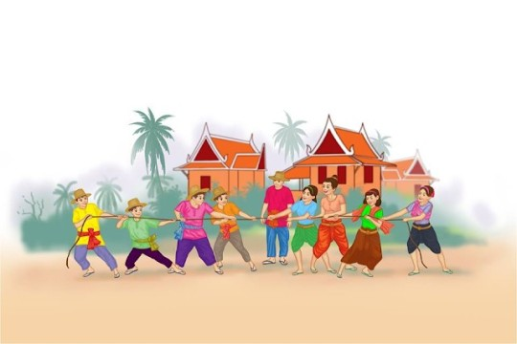
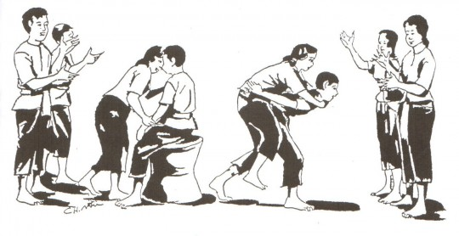
Khmer New Year Games
Tugging Rituals and Games
Tugging Ritual and Games was inscribed on the Representative List of the Intangible Cultural Heritage of Humanity on 02nd December 2015.
Sdech Jang Game (King Game)
Sdech Jang or King Game is a game that boys, girls, or teenagers from every village all over Cambodia, always play during their free time at nighttime under the moonlight. When playing, they are divided into two groups, one male, and one female. In both groups, they set up a male or a female as a king to sit in the center.

Slide 27
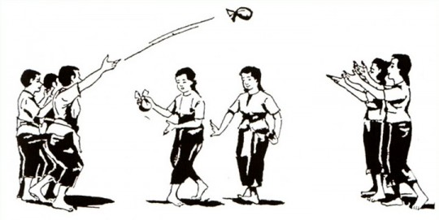
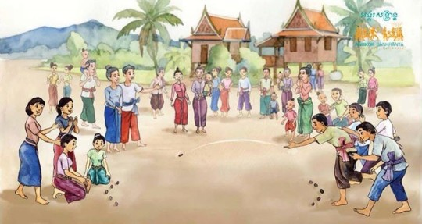
Khmer New Year Games
Chhoung Game
“Chol Chhoung”, known as “Chhoung”, is one of the most famous Khmer folk games. This game can ignite all players' joy, bonding, and fascination. Moreover, this is the type of Khmer throwing game that everyone, especially teens and young adults, plays at the pagoda during Khmer New Year in April.
Tugging Rituals and Games
Bos Angkunh is a popular Khmer traditional game played especially during Khmer New Year at villages, or schools, especially at the pagodas. Angkunh is called after one kind of dried fruit from a climbing plant in Cambodia. Normally, this game could help maintain people's mental and physical dexterity.

Slide 28
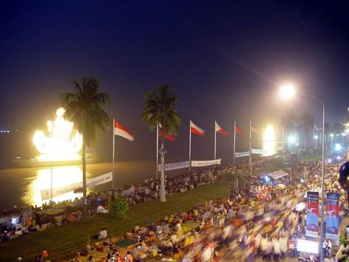
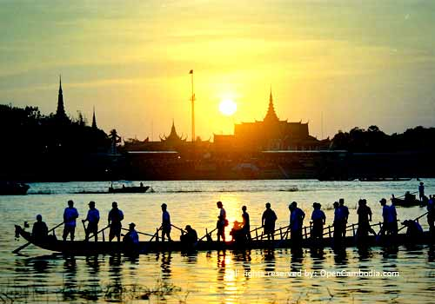
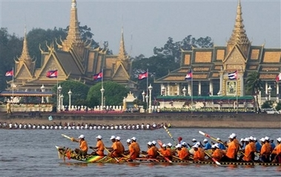
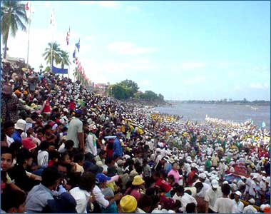
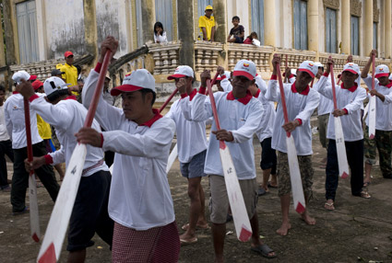


Festival in Cambodia
Water Festival
Water Festival Another very colorful festival is the Water Festival or the Festival of the Reversing Current.
It takes place in late October or early November and marks the reversal of the Tonle Sap River so that it once again flows south from the Tonle Sap Lake into the Mekong River.
The highlight of the three-day festival is the boat races that are held in Phnom Penh. Individual villages build their own boats by hollowing out a log to make a dugout canoe that is rowed by as many as forty people!
The prow and the stern of the canoe turn upward, and the prow is painted with an eye, just like the war vessels on the wall of the temples at Angkor Thom.

Slide 29


Festival in Cambodia
Water Festival
History
According to historical records and inscriptions expressed that Jayavarman VII ascended to the throne in the capital of in Yasodharapura and reconstructed the national reconstruction such as the construction of temples, hospitals, roads, and irrigation systems throughout the country.
The Festival has been held since the age of Angkor, and Cambodian people always hold the Festival along with all kind of boat racing, both men, and women from all over the country.

Slide 30





Festival in Cambodia
Pchum Ben Festival
Pchum Ben is a religious ceremony in September when everyone remember the spirit of dead relatives.
For fifteen day people in Cambodia villages take turns bringing food to the temple or Pagodas.
On the fifteenth and final day everyone dresses in their finest clothing to travel together to pagodas .Families bring overflowing baskets of flowers and children offer food and present to the monk.
Everyone says prayers to help their ancestors pass on to a better life.

Slide 31




Festival in Cambodia
Birthday Festival
Birthday’s Cambodian children do not
Celebrate their birthday and it is not a
Special day for them. Often their parent just remember what season they were born in but not the exact day so they don’t know for sure.
However, all Cambodian know which year they were born and what it means in born and what it means in the Chinese animal calendars. Do you know which year were you born in and which characteristics.
But nowadays, we change.

Slide 32





Festival in Cambodia
Weddings are the most important social events in the lives of young people.

Slide 33



Cambodian Food
Khmer Food
Samlor Kako: is one of Cambodian national dishes. It uses an incredible range of ingredients to achieve its complex range of flavors, including the famous prahok
Hamok Trei or Amok Trei Fish Hamok, also known as Hamok Trei, is a staple of Cambodian cuisine and a must-try for visitors worldwide hoping to gain a deeper understanding of the nation and its people.
Num Ansorm cakes are made of sticky rice packed with freshly leaves (normally banana leaves), cylindrical shape, cooked by steam or grill.

Slide 34









Cambodia tourist attractions

Slide 35




Angkor Wat
.Angkor Wat - One of the top 7 'Wonders of the World' for travelers | UNESCO Cambodian temples
Angkor wat is the largest religious structure ever built.
Angkor Wat is a Hindu temple complex built to replicate the heavens on earth, meaning "City Temple". It was initially constructed for King Suryavarman II in the early twelfth century, during his reign from 1113 to 1150 with astronomical and cosmic rhythm and Hindu influence dedicated to Vishnu.
Estimated construction time of the temple is around 30 years.

Slide 36





Bayon Temple-the main temple of Angkor Thom in Angkor Area
Bayon Temple was built by Kinf Jayavarman VII, It was built in the 12th century, is at the center of Angkor Thom.
The 216 enormous smiling Avalokiteshvara faces ornament its 54 Gothic towers, and 1.2 kilometers of remarkable bas-reliefs feature more than 11,000 figures.
At first glance, Bayon appears more like a legendary stack of ruins than a majestic temple. However, only after you explore the temple and ascend to the third floor can you truly appreciate its power.

Slide 37


Cambodian language

Slide 38
Learn Khmer Language
Hello jum-reap soo-a
How are you? tau neak sok sapbay teh?
I’m Fine! Knhom Sok sabay.
Good morning arun sour sdei
Good Bye! jum-reap Lea
Good night tiveah sour sdei
What is your name? tau neak Chhmus Ah Vey?
My name ……………. Knhom Chhmus…………
Good La or
Beautiful Sa art
Delicious Chha nganh

Slide 39
Reference
http://geography.about.com/library/cia/blccambodia.htm
http://www.asiarooms.com/travel-guide/cambodia-tourist-attractions/index.html
http://cambodia.tourism-asia.net/cambodia-information.html
http://cambodia.tourism-asia.net/cambodia-tourism.html
http://cambodia.tourism-asia.net/wonders-of-cambodia.html
https://intocambodia.org/category/popular-dance

